Slide 1
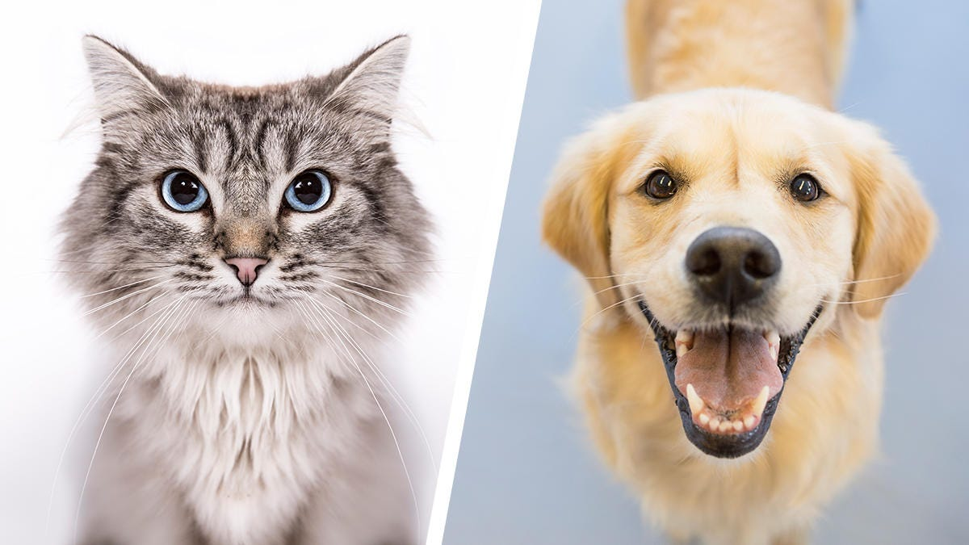
CAPSTONE PROJECT
GROUP 3
DOGS AND CATS CLASSIFICATION

Slide 2
01
ABSTRACT
EXPLORATORY DATA ANALYSIS (EDA)
03
PREPROCESSING
TABLE OF CONTENTS
02
04
MODEL BUILDING
05
RESULTS
06
CONCLUSION & IMPROVEMENTS

Slide 3
01
ABSTRACT

Slide 4
ABSTRACT
Data preprocessing
Feature extraction
Modeling
Performance evaluation
Resizing
Normalization
Augmentation
Histogram of Gradient (HOG)
K-Nearest Neighbors
Support Vector Machine
Random Forest
Gradient Boosting
K-means
Convolutionary Neural Network
Accuracy
Precision
Recall
Confusion matrix
F1 score
Cross-validation
The classification of images is a fundamental task in computer vision, and distinguishing between cats and dogs has long been a popular challenge in this field.

Slide 5
02
EXPLORATORY DATA ANALYSIS (EDA)

Slide 6
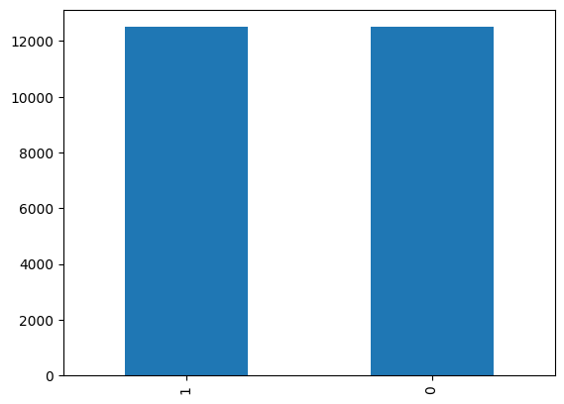
EXPLORATORY DATA ANALYSIS (EDA)
Dataset:
Contains 25000 images.
Equally devided into 2 categories: dog and cat.
Figure 1. Image Distribution

Slide 7
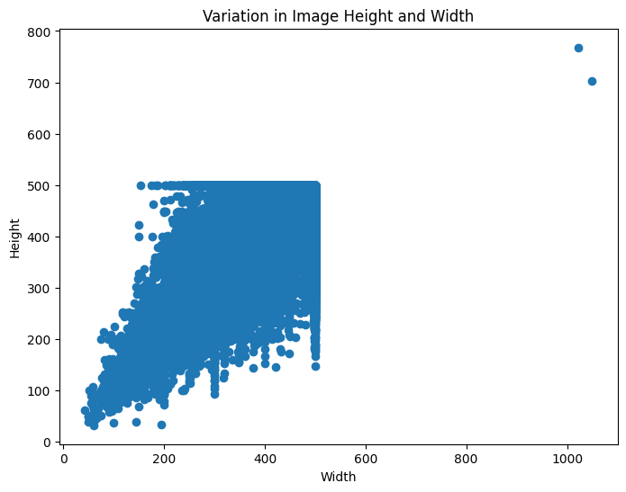
EXPLORATORY DATA ANALYSIS (EDA)
Dataset:
Varied in resolution (from 50x38 to 1023x768).
Need to be resized to one resolution for later processing.
Figure 2. Variation in image resolution

Slide 8
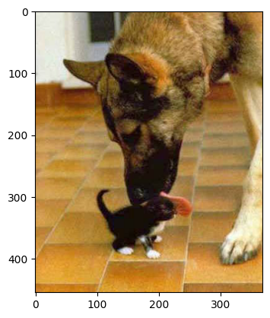
EXPLORATORY DATA ANALYSIS (EDA)
Noises in data
A dog appears in a cat image.
A person appears in a dog image.
Figure 3. Image cat.724.jpg: a dog in a cat picture

Slide 9
03
PREPROCESSING

Slide 10
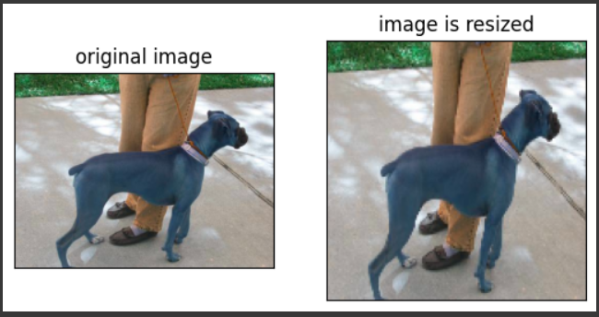
PREPROCESSING
Image preprocessing
We resize the images to 150x150.
The resized images will be represented as a tensor 3D of size 150x150x3 with 3 channels Red, Green, Blue.
Figure 4. Original image vs. resized image

Slide 11
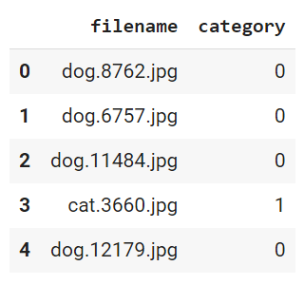
PREPROCESSING
Label encode
Dog will be encoded to 0.
Cat will be encoded to 1.
Figure 5. Class encoded

Slide 12
PREPROCESSING
Feature extraction (HOG)
The key point in HOG's principle of operation is that the form of a local object can be described through two matrices, that is, the magnitude of the slope (the magnitude of the slope) and the slope of the matrix. direction (slope direction).
So how are the above 2 gradient matrices generated? The image is first divided into a grid of squares and on it we define a lot of local areas that are contiguous or overlapping. These regions are similar to the local image-set configuration regions that we compute the convolution in the CNN algorithm. A local area consists of many local cells (in the HOG algorithm 4) that are 8x8 pixels in size. Then, a graph histogram of the steep slope statistics is calculated on each local set of plots.
The HOG descriptor (HOG descriptor) is created by concatenating 4 vector histograms corresponding to each cell into a composite vector. To improve accuracy, each value of the vector plot on the local area will be normalized to a 2nd or 1st order standard. This normalization variable is intended to provide better invariance to changes in lighting and shading references.

Slide 13
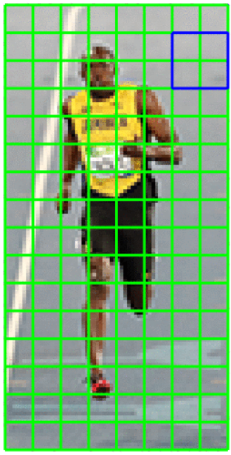
PREPROCESSING
Feature extraction (HOG)
Local region
Local cell

Slide 14
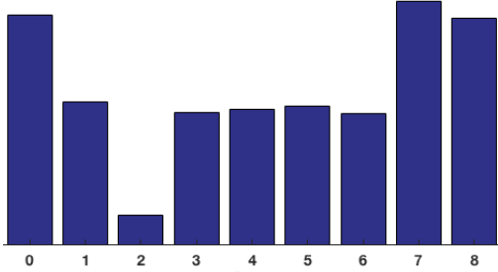
PREPROCESSING
Feature extraction (HOG)
Histogram of oriented object of a local cell is shown, for example, as shown in Figure below:
Histogram of Gradient consists of 9 bins corresponding to a square in the grid.

Slide 15
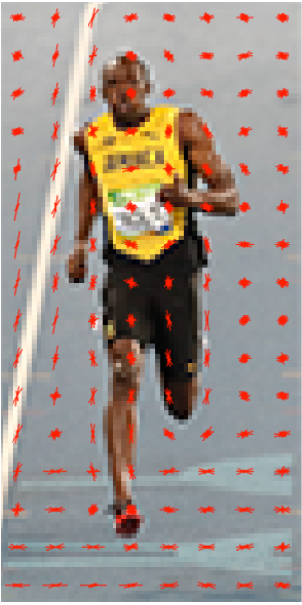
PREPROCESSING
Feature extraction (HOG)
Concatenate 4 vector histograms of 4 local cells in a local region (block) we get a vector histogram of the block in question with shape (1,36), then normalize this vector.
Do the same with other blocks and concate the blocks. Vector histogram of blocks together, we get a histogram of oriented gradient describing the original image.
Histogram of Oriented Gradient which describe the object's feature

Slide 16
04
MODEL BUILDING

Slide 17
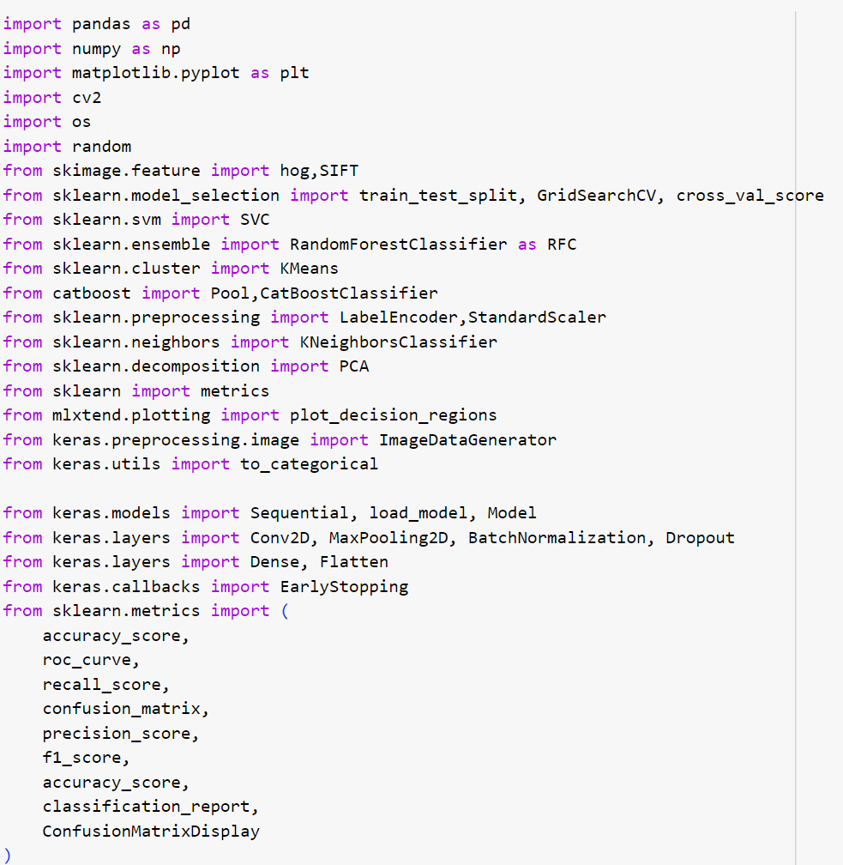
MODEL BUILDING
Import libraries
Figure 5. Class encoded

Slide 18
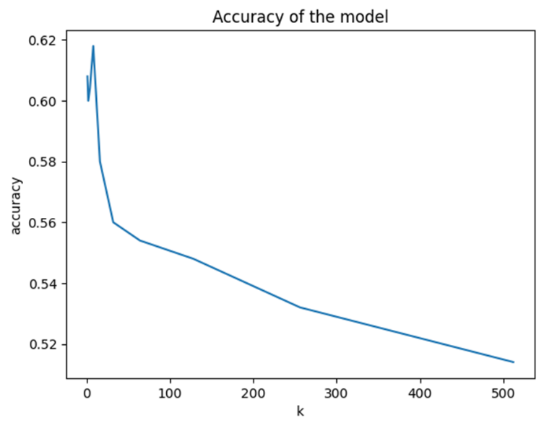
MODEL BUILDING
Models
KNN
We train the model using the divided dataset to find the best hyperparameter k for the model.
On the right is a graph comparing the performance of the model for different k values.
After tuning, we found out that k=4 is the best value for k.
Figure 10. Accuracy of the model with corresponding k

Slide 19
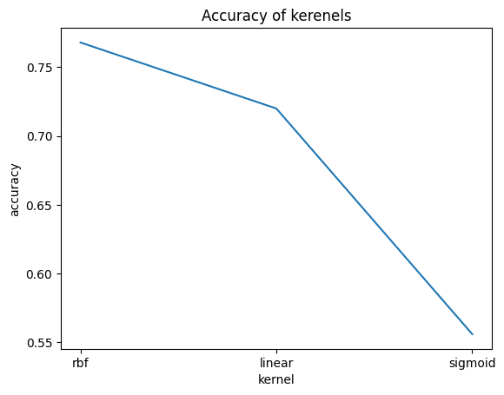
MODEL BUILDING
Models
SVM
There are 3 most common hyperparameters we can tune:
Kernel
C
Gamma
The rbf gives us the best performance among the 3 kernels
→ Chosen to tune the next hyperparameter (Gamma).
Figure 11. Performance of the model with each kernel

Slide 20
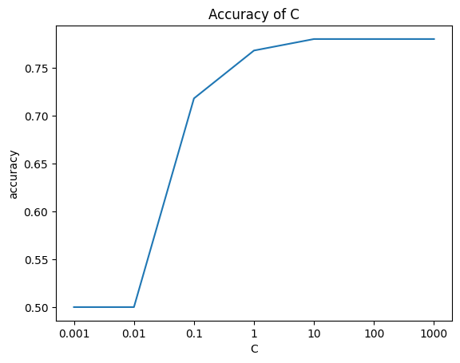
MODEL BUILDING
Models
SVM
The performance of the model with the values of C: 10, 100, and 1000 is the same.
→ C = 10 is chosen to get a wider and clearer separation margin.
Figure 12. Performance of the model with each C parameter when the permanent kernel is rbf

Slide 21
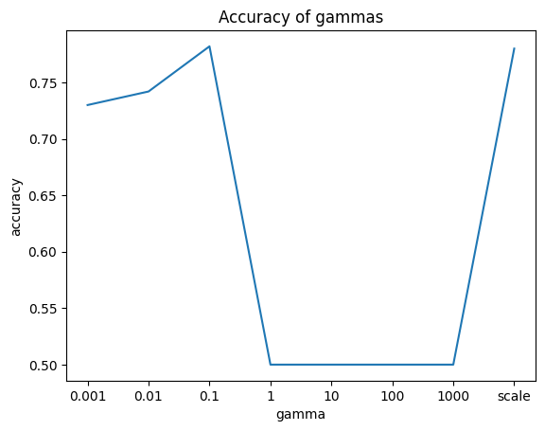
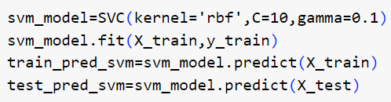
MODEL BUILDING
Models
SVM
From the histogram, we decided to choose the gamma value as 0.1.
In short, we have the best parameter set to fit and predict on the original data is (Kernel: rbf; C: 10, Gamma: 0.1)
Figure 13. Performance of the model with each Gamma parameter when the permanent kernel is rbf and C=10

Slide 22
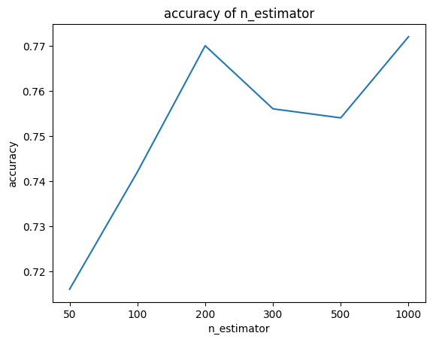
MODEL BUILDING
Models
Gradient Boosting (Catboost)
We are tuning 2 hyperparameters:
Iterations
Learning rate
When iterations = 1000, we have the best accuracy on test set for tuning.
Figure 14. Model’s performance with each iterations (n_estimators)

Slide 23
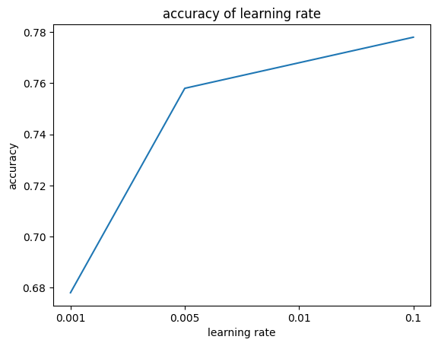
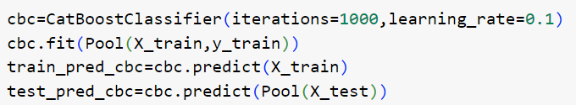
MODEL BUILDING
Models
Gradient Boosting (Catboost)
When iterations = 1000 and
learning rate = 0.1, the model has
the best performance.
Figure 15. Model’s performance with each learning rate when iterations = 1000

Slide 24
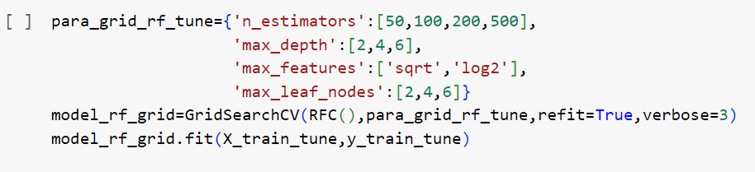
MODEL BUILDING
Models
Random Forest
We choose 4 parameters for tuning:
n_estimator
Max_depth
Max_feature
Max_leaf_nodes
To find the best hyperparameter set for our model, we used Grid Search then we train our model with the best parameter found.

Slide 25
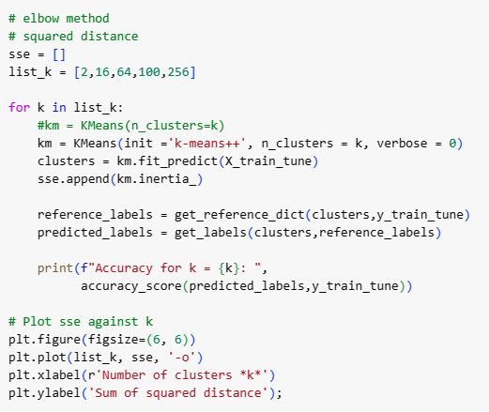
MODEL BUILDING
Models
K-means Clustering
We will use the elbow method to select the appropriate k.

Slide 26
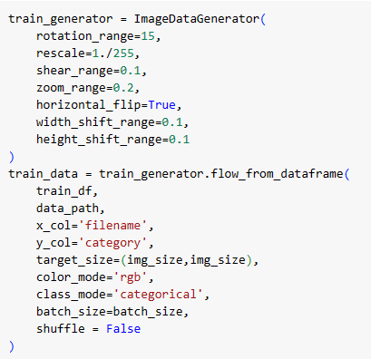
MODEL BUILDING
Models
Convolutional Neural Network (CNN)
We will replace feature extraction with ImageDataGenerator.
→ Allows applying various data augmentation techniques to the images
in realtime during training.

Slide 27
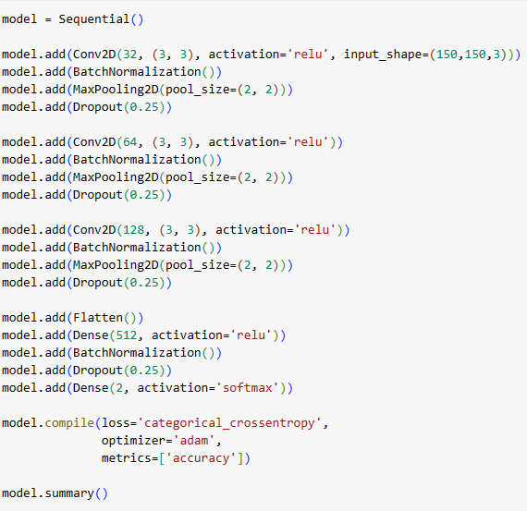
MODEL BUILDING
Models
CNN
Our CNN model is shown on the right with 8 layers:
Conv2D Layer
BatchNormalization Layer
MaxPooling2D Layer
Dropout Layer
Flatten Layer
Dense Layer
Another BatchNormalization & Dropout Layer
Output Layer
→ The model is then compiled with a categorical cross-entropy loss function, Adam optimizer, and accuracy metric.

Slide 28
05
RESULTS

Slide 29
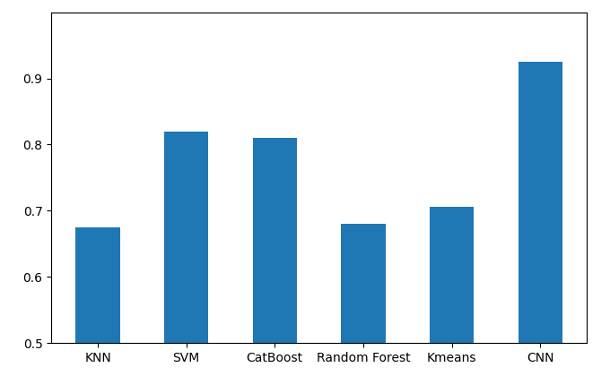
RESULTS
Total comparison
Figure 22. Comparison between models

Slide 30
06
CONCLUSION & IMPROVEMENTS

Slide 31
CONCLUSION AND IMPROVEMENTS
Conclusion
Our models (except for CNN) have a result of 70-80% accuracy, which is acceptable because image classification is a difficult task for them.
The CNN model executes significantly better than the rest with 93% accuracy.
Improvements
There is still a lot of room for improvements.
We are going to try some other methods, e.g, further tuning or transfer learning to make our model works better.

Slide 32
Thank you!
Team members & contact
Nguyen The An an.nt210006@sis.hust.edu.vn
Dau Van Can can.dv214879@sis.hust.edu.vn
Do Dinh Kien kien.dd214906@sis.hust.edu.vn
Reference
Dataset: https://www.kaggle.com/competitions/dogs-vs-cats/data
Libraries: https://scikit-learn.org/

